Slide 1
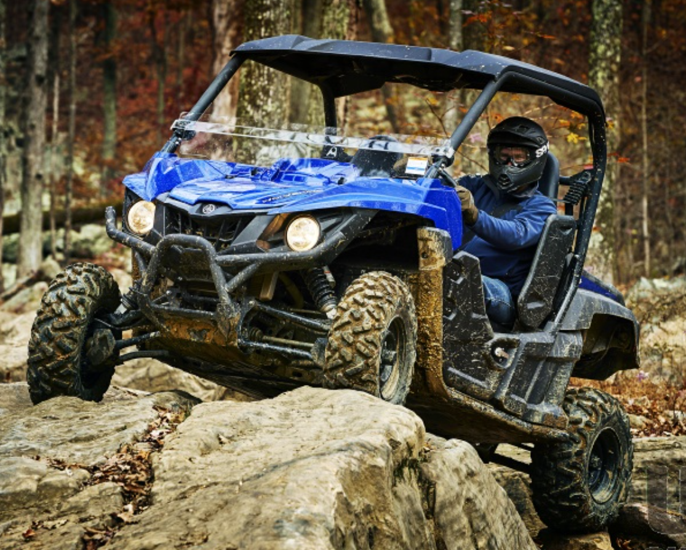
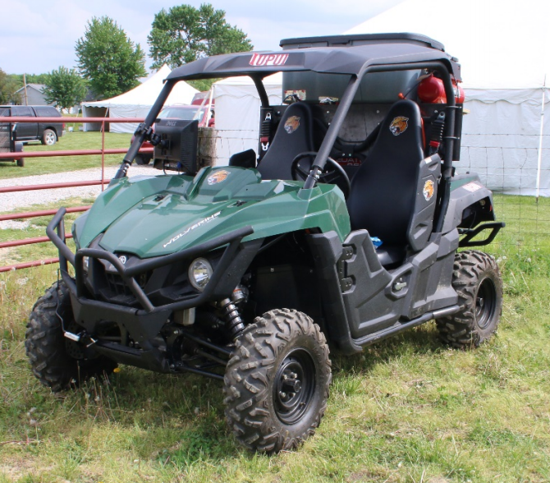
Final Presentation for MEE AgBot 1
4/30/2021
Sponsors:
Sohel Anwar - soanwar@iupui.edu (317) 274-7640
&
Seemein Shayesteh - shayests@iupui.edu (317) 278-6211
John Baker, Trevor Baxter, Ryan Knight, Parth Patel, Austin Van Haitsma
‹#›

Slide 2
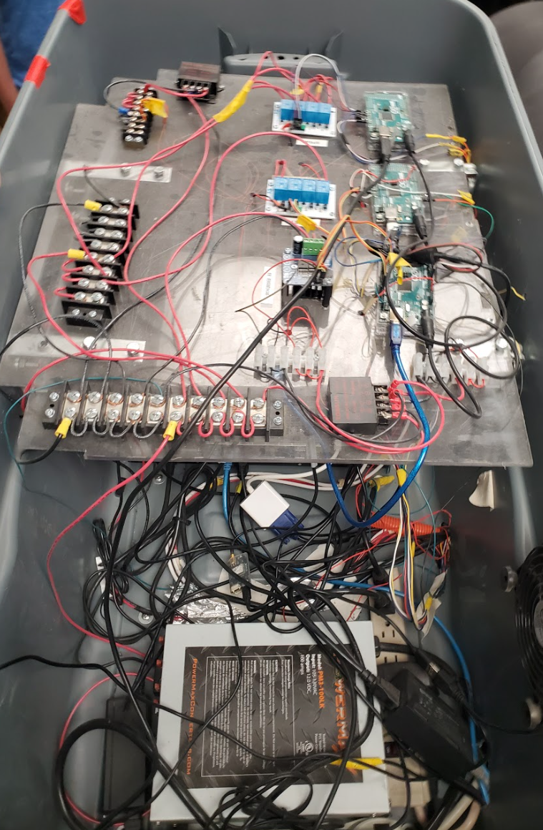
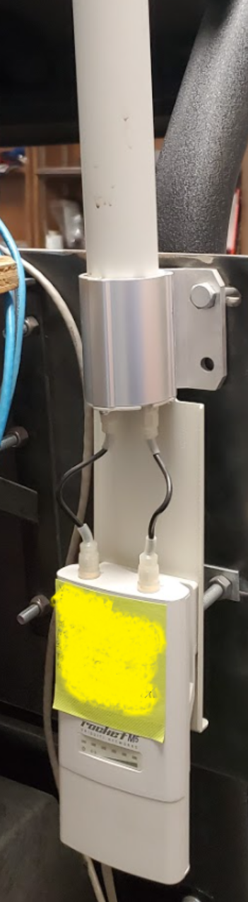
Project Background and Motivation John Baker
Design a navigation system that can accept real time speed data and implement Real Time Kinematic (RTK) global positioning
Navigation signal is transmitted through a 3rd party base station
5th Iteration of the Purdue Agricultural Robot
Data from the navigation system will be used to optimize the Rover’s physical capabilities
Provide safe and reliable product to our sponsor while minimizing carbon footprint

Slide 3
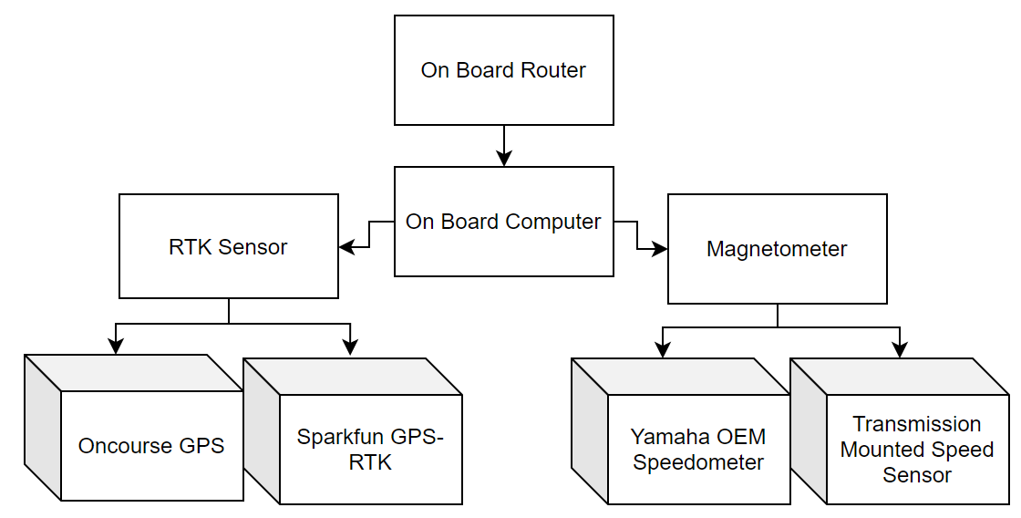
System Design Overview John Baker
Agbot Group I implemented two design options within the Navigation subsystem
Speed sensor data is used to compute further subsystem objectives

Slide 4
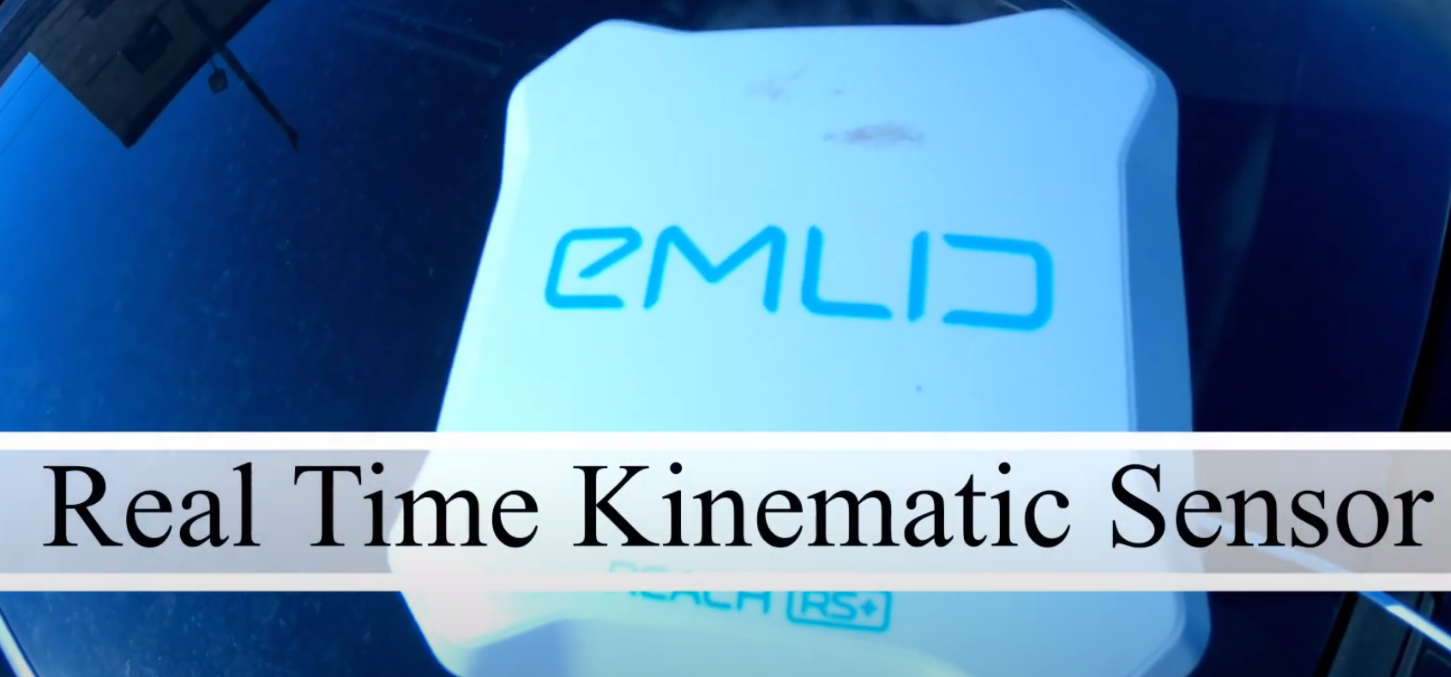
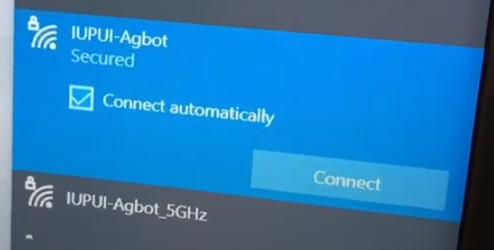
Technical Requirements John Baker
Operate either autonomously or manually through a field with numerous 500-ft rows
Sensory data shall be transmitted back to base station in real time
Minimized Electromagnetic interference for RTK, GPS, and Wi-Fi while in operation

Slide 5
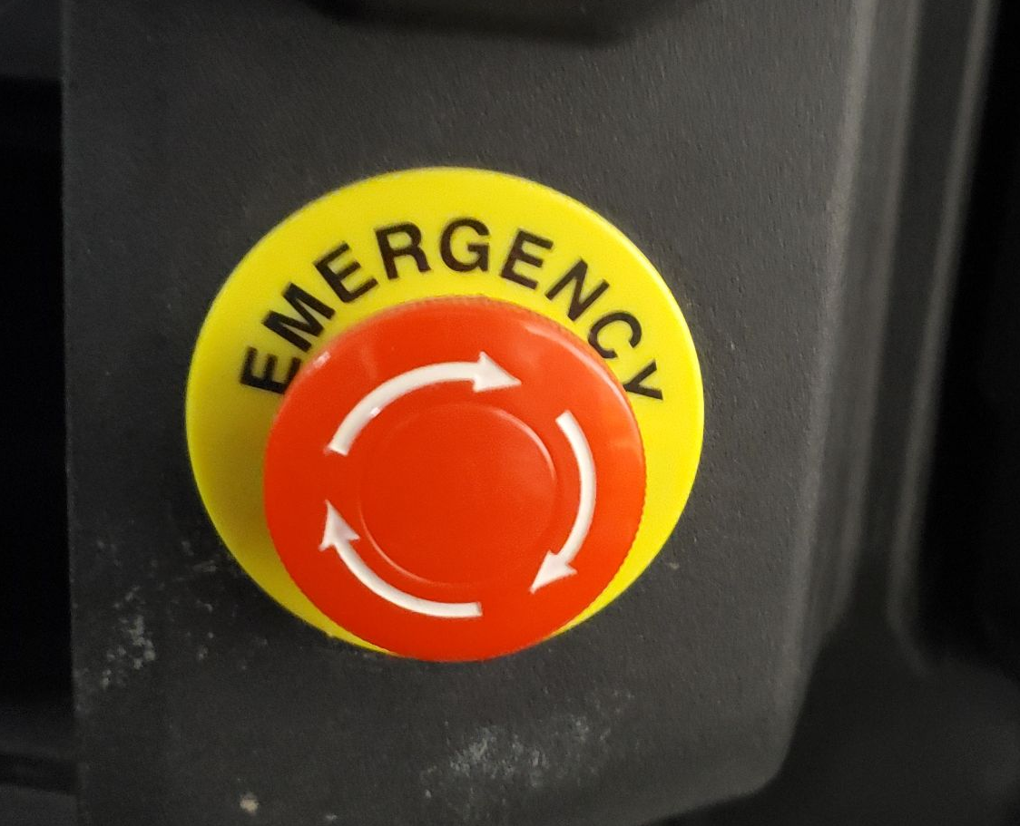
Safety Requirements Austin Van Haitsma
The AgBot must stop when a kill switch is used.
Only weeds should be sprayed with chemicals.
Operations must stop if obstacles are detected.
GPS signal is used if RTK signal is lost.

Slide 6
Speed Sensor Options Austin Van Haitsma
Use On-Board Sensor | Configuring a New Sensor (Yamaha 5TJ83755C100)
Pros: Cost-effective Less moving parts Durable | Pros: Less risk of breaking subsystems Versatile Deeper understanding of sensor
Cons: More risk of breaking sensor during setup Requires in-depth knowledge of system | Cons: Costly Potential Incompatibility Prone to failure

Slide 7
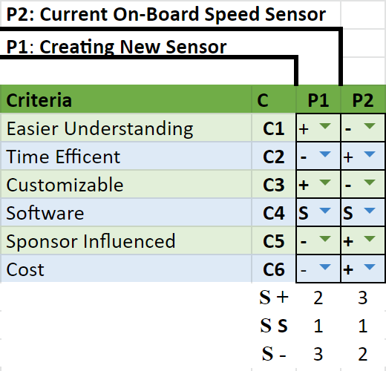
Pugh Matrix for Speed Sensor Austin Van Haitsma
As indicated, isolating speed data from on-board sensor was the better option.
Primarily because it was more time-efficient and customizable.
Thus, we decided on using the current sensor.

Slide 8
GPS Options Ryan Knight
Configure Current On-Board RTK | Purchase a New RTK (Sparkfun GPS-RTK2-ZED-F9P)
Pros: Cost-effective Time-Efficient No Additional Installation Previous team members as a knowledge resource | Pros: Easy Integration Customizable Capabilities RTK - up to 20Hz Concurrent reception of GPS, GLONASS, Galileo and BeiDou
Cons: Software Issues Knowledge Barrier | Cons: Costly Time-Inefficient Potential Incompatibility Minimal amount of documentation
Notes:
We started with two options, either utilizing the current RTK system or purchasing a new system. We ultimately decided to keep the current RTK system as it was the best option from a cost and time perspective, though there was a knowledge barrier and some software issues that we have encountered.

Slide 9
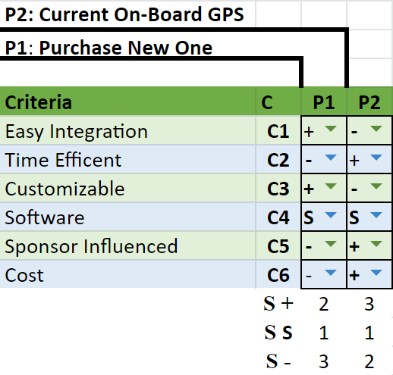
Pugh Matrix for On-Board GPS Ryan Knight
Utilizing the current on-board GPS had more benefits compared to purchasing a new system
For this reason we decided to keep the current system
Notes:
This is our Pugh Matrix for the on-board GPS. We decided early on that it would be best to utilize the current hardware for our GPS and RTK systems as we found there were more benefits compared to purchasing a new system.

Slide 10
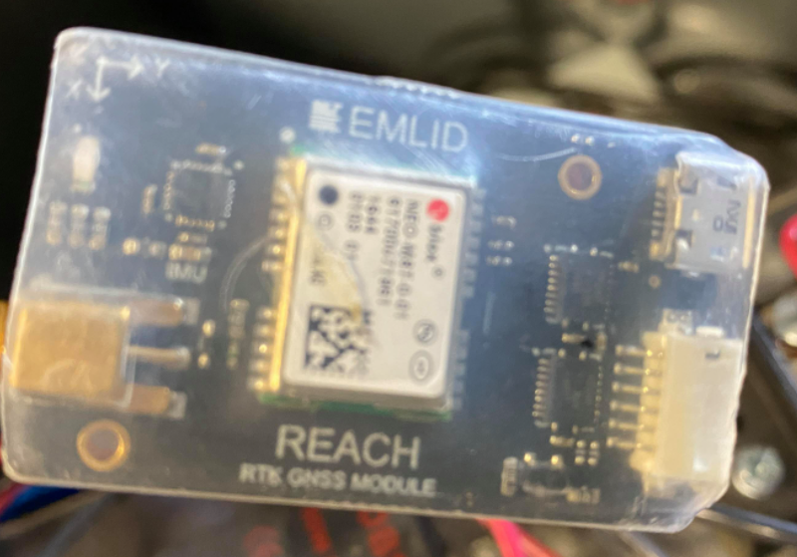
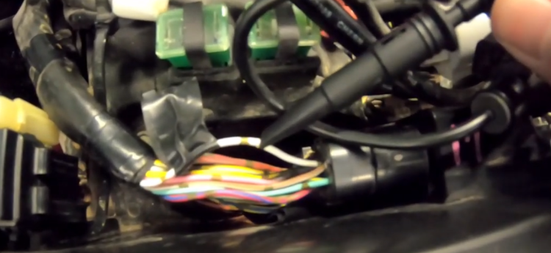
Analysis Ryan Knight
Testing on individual subsystems first, then test all subsystems together to check AgBot functionality
Testing site was not available for a majority of the semester, so indoor testing became extremely important
Work on RTK and speed sensor became top priority to finish before test site became available
RTK Sensor
Speed Sensor Wire
Notes:
Once the subsystems were tested individually, the AgBot was tested as a whole. Due to the AgBot being in a small workspace for most of the year, we were only able to test outside during the late phase of the semester. After moving the AgBot, we were able to integrate the RTK module and view the RTK data in real time at a base station computer which allowed us to verify that the system was accurate in its positioning.onomously.

Slide 11
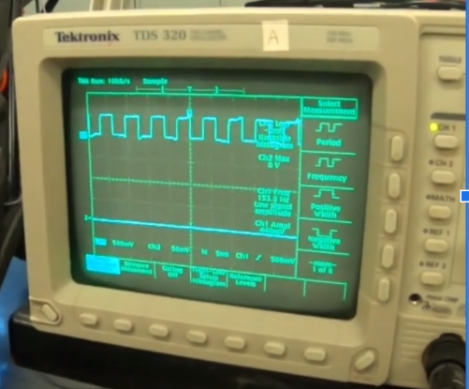
Testing Procedure & Results Parth Patel
Speed sensor was tested by lifting up the AgBot and tapping into the speed sensor wire with an oscilloscope.
Able to understand the waveform output and where the speed data is located in the system

Slide 12
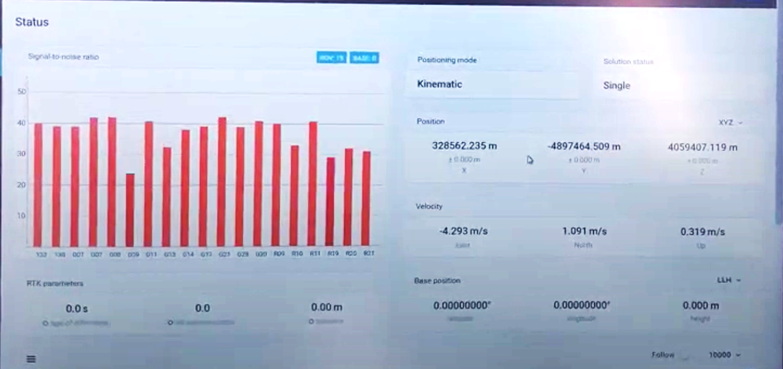
Testing Procedure & Results Parth Patel
RTK data accuracy was tested by driving the AgBot in the parking lot and verifying the data on a laptop.
The GPS module was improved upon and reading a more accurate position of the AgBot

Slide 13
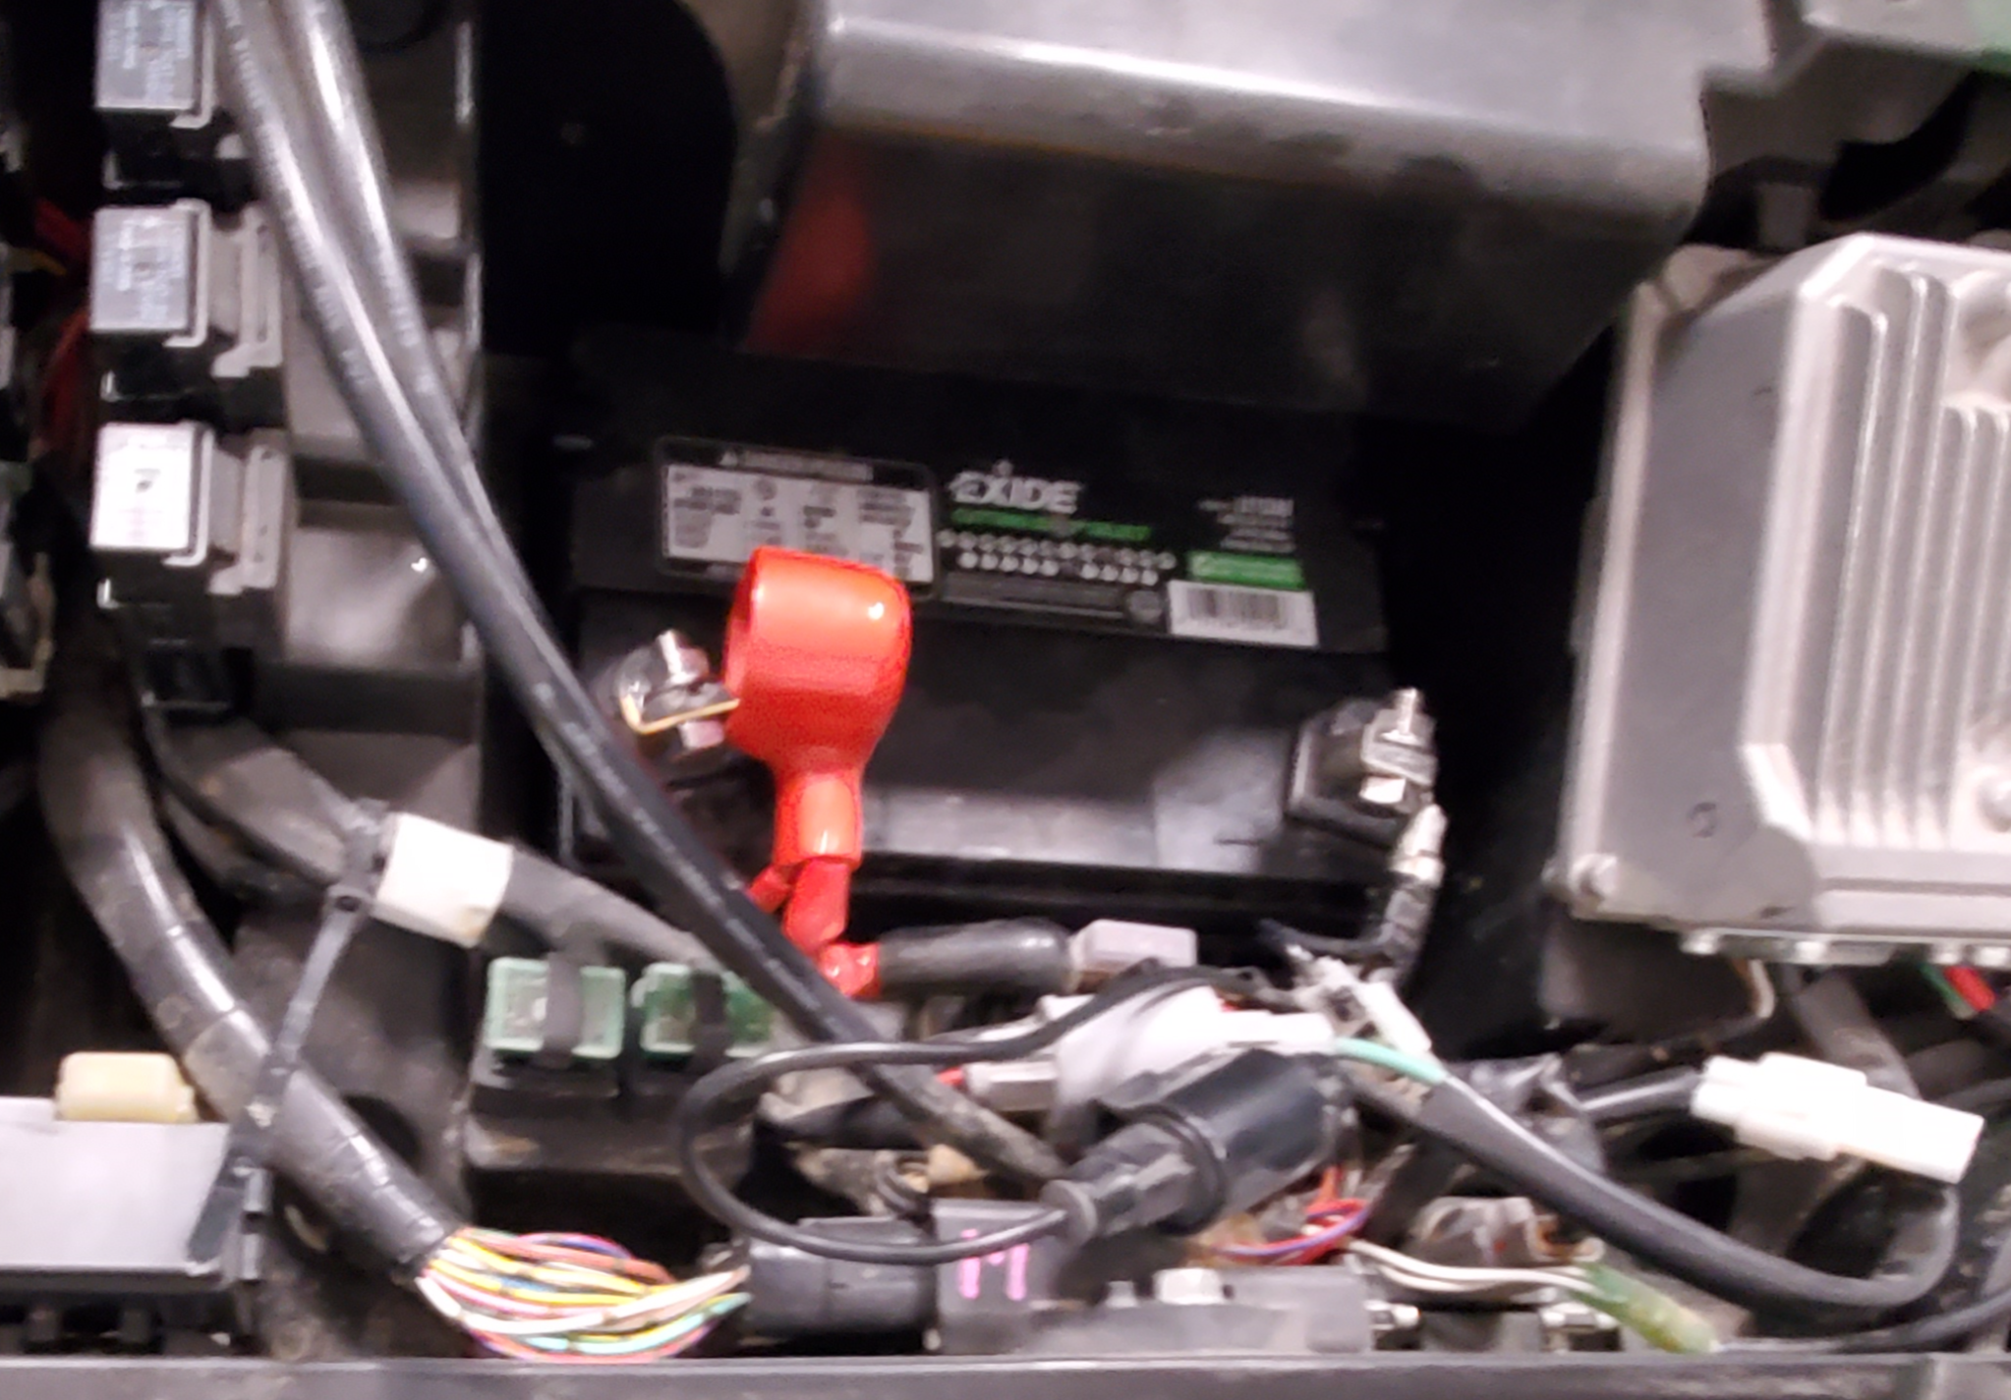
Challenges and Solutions Parth Patel
Vehicle engine would not start
Replaced battery
Mechanical system controlling
throttle sticking to a bearing
With only testing scripts working in autonomous mode, this issue was still unsolved as it could be a software error or hardware error
Battery

Slide 14
Challenges and Solutions Parth Patel
On-board computer failing to boot up
Replaced SATA cable, still slow to boot up and may be an issue of updating the computer.
Unknown error codes after implementing every subsystem together
Implemented 3 years ago and outdated, need to update the complete ROS package.

Slide 15
Conclusion Trevor Baxter
Able to learn ROS to debug code from the current system
Able to clean up files and create a new startup file
Able to understand the on board speed sensor and output waveform
Able to implement GPS module to have a more accurate reading on the AgBot
Overall a great project to learn more about autonomous driving systems
Notes:
The AgBot is a complex project that requires knowledge on a large number of topics. The team working on this project comes from varying backgrounds with different skills and life experiences. By working together, the skills known by each team member can be used to improve upon the previous iterations of AgBot.
The AgBot team was able to see a system that combined hardware and software. The team had to learn to use ROS and Python to work on the software that was created by previous groups for the AgBot. By working on the Yamaha Wolverine, the team was able to gain a better understanding of automotive technology. The team also gained experience working with embedded systems where multiple microcontrollers were used to connect multiple sensors that would be used to perform various tasks by the AgBot.
Our Agbot team was able to create another folder and clean up some duplicate files for a startup sequence. This allowed us to narrow down our error codes and where they were coming from. Our team worked with a previous team lead of the project as he informed us a lot of files on the computer were unnecessary and not working properly.
Overall, this project was a look at how projects are done in the workforce. Engineers work on projects that combine multiple subsystems that do various tasks and these systems must be integrated properly for the project to be successful.

Slide 16


Future Work Trevor Baxter
Install Ubuntu 20.04 or the latest version
Install ROS Melodic/Noetic
Update autonomous driving codes from ROS Wiki
Upgrade onboard PC depending on budget

Slide 17
Thank You!
Any Questions?

